Slide 1
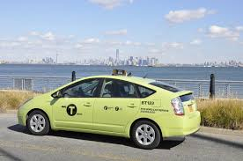
NYC Taxi and Limousine Commission (TLC) Green taxi rides
Presenters - Nainil Pankajbhai Patel

Slide 2
Summary
Introduction to Dataset
Variables
Data Preprocessing
Research Questions (Insights)
Visualizations (Dashboard)
Classification model (Logistic Regression)

Slide 3
NYC Taxi and Limousine Commission (TLC)
Mission statement is to provide access to New Yorkers and Visitor
Types of taxis – Green / Yellow / For-Hire
Data to NYC TLC is provided by Taxicab & Livery Passenger Enhancement Programs (TPEP/LPEP)

Slide 4
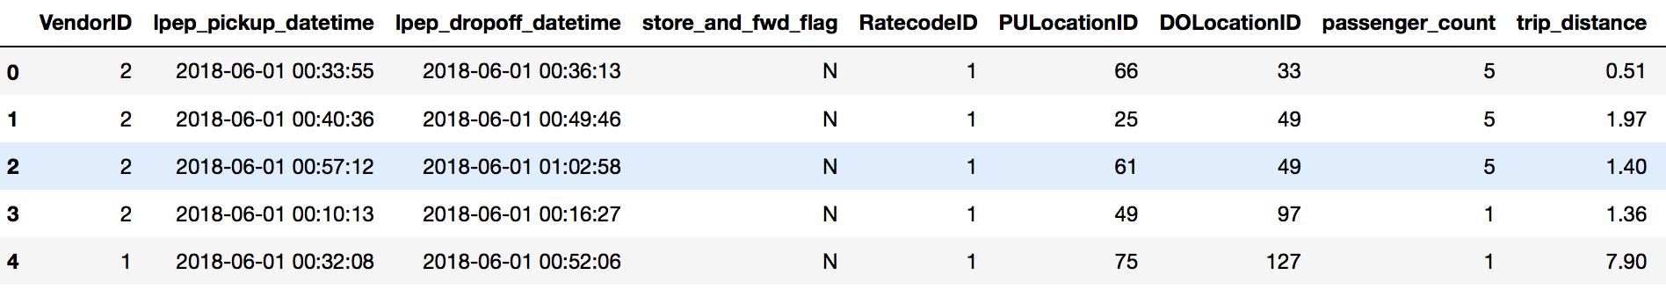
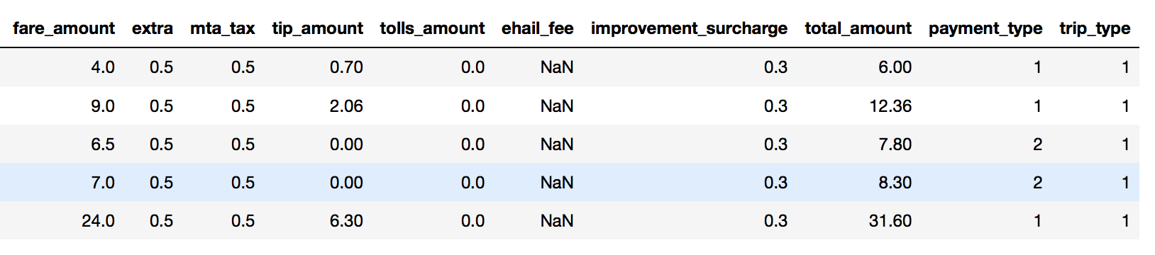
Green Taxi trip Dataset

Slide 5
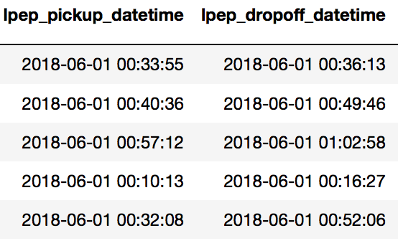
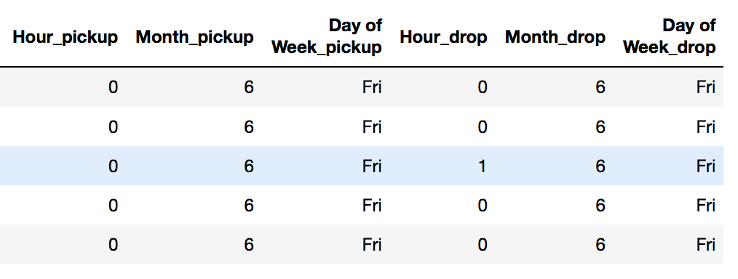
Data preprocessing
Removing columns with null values
Parsing the Datetime column
Splitting the date into month, hour and
day of week
Mapping string name
to day of week

Slide 6
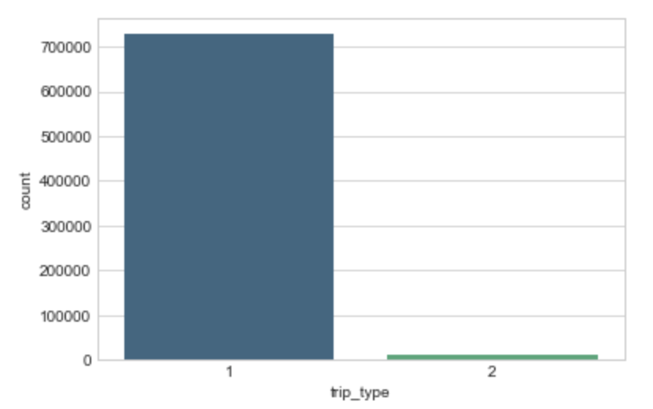
Analysis of Trip type variable
Rides by Street hail trip type - 727734
Ride by Dispatch trip type - 11639

Slide 7
#1 At what time taxi’s should be more available?
Street hail trip type rides are mostly requested at 6 pm
Dispatch trip type rides are mostly requested at 8 am
Dissimilarity among both the trip types
Street hail are requested at leaving office hours
Dispatch are requested at starting office hours

Slide 8
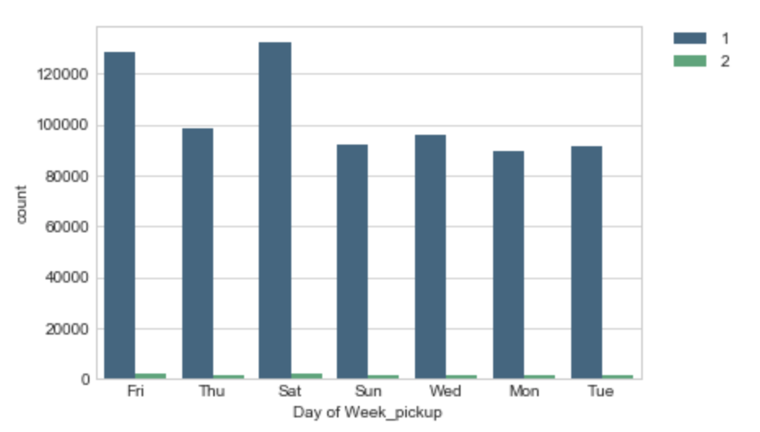
#2 Which is the busiest day?
Street hail trip type is mostly used on Saturday
Dispatch trip type is mostly used on Saturday
Similarity amongst trip type
Evident because of weekend

Slide 9
#3 Which location of New York request most rides?
Most of street hail trip type pickup location is 74
Most of Dispatch trip type pickup location is 244
Dissimilarity amongst the trip type
Both trip type are dominant in different locations

Slide 10
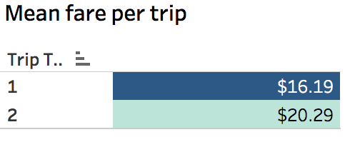
#4 Which type of rides have higher mean fare?
Street hail trip type rides have mean fare of $16.19
Dispatch trip type rides have mean fare of $20.29
Great, street hail type of rides have the maximum numbers of ride but is not necessarily to have higher mean fare per ride
Dispatch trip types have much lesser rides but there mean fare per ride is higher

Slide 11
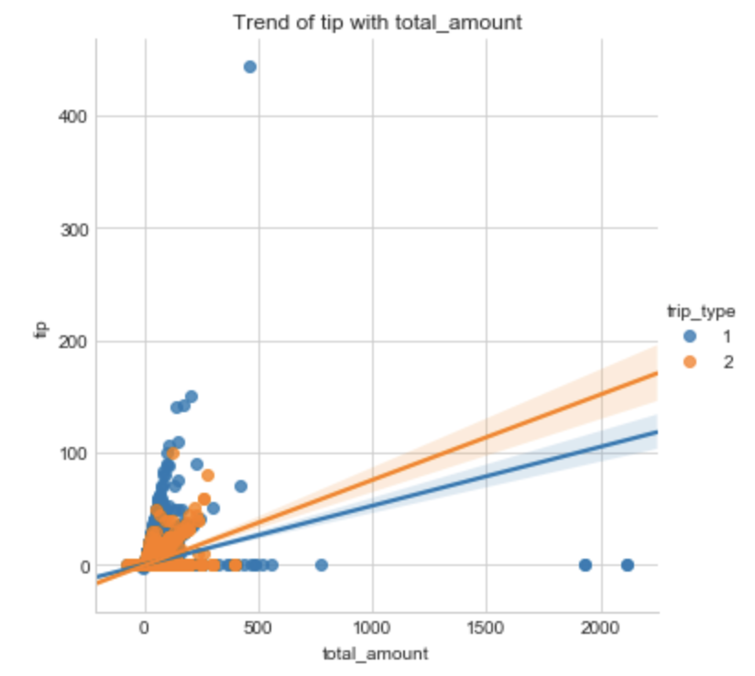
#5 Is there any trends in tips?
With more observations for street hail trip type there are more tips given
The trend shows that there are better probability that dispatch trip type is given more tips with increase in fare amount than street hail trip type
One shocking thing is there was a trip made by street hail trip type, the total amount of the trip was $461.24 and tip_amount was 444.44

Slide 12
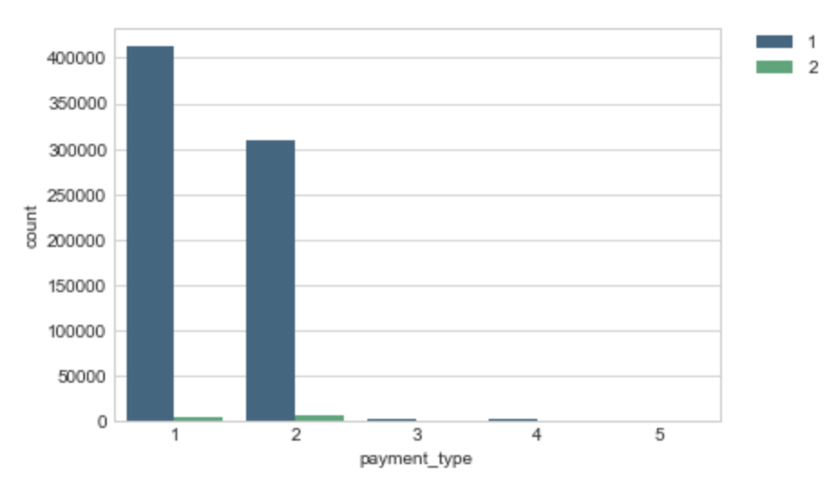
#6 How is the payment made?
Distribution of payment type by customer 1= Credit card 2= Cash 3= No charge 4= Dispute 5= Unknown
Customer payments to street hail trip type is often with credit card
Customer payments to dispatch trip type is often with cash

Slide 13
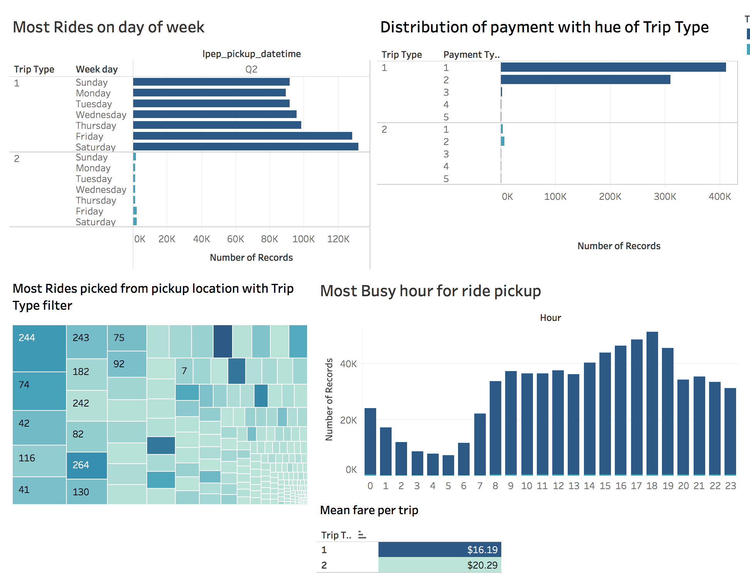
Dashboard

Slide 14
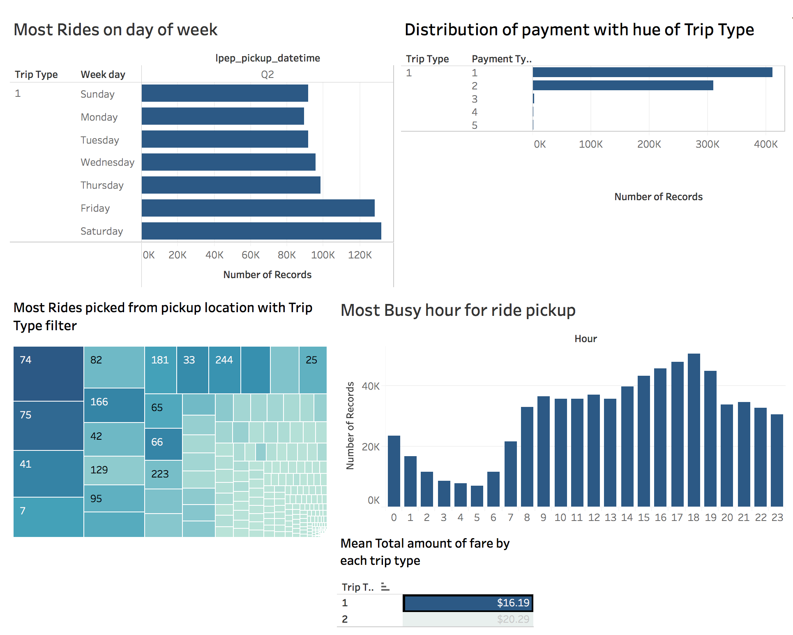
Dashboard for Street hail trip type

Slide 15
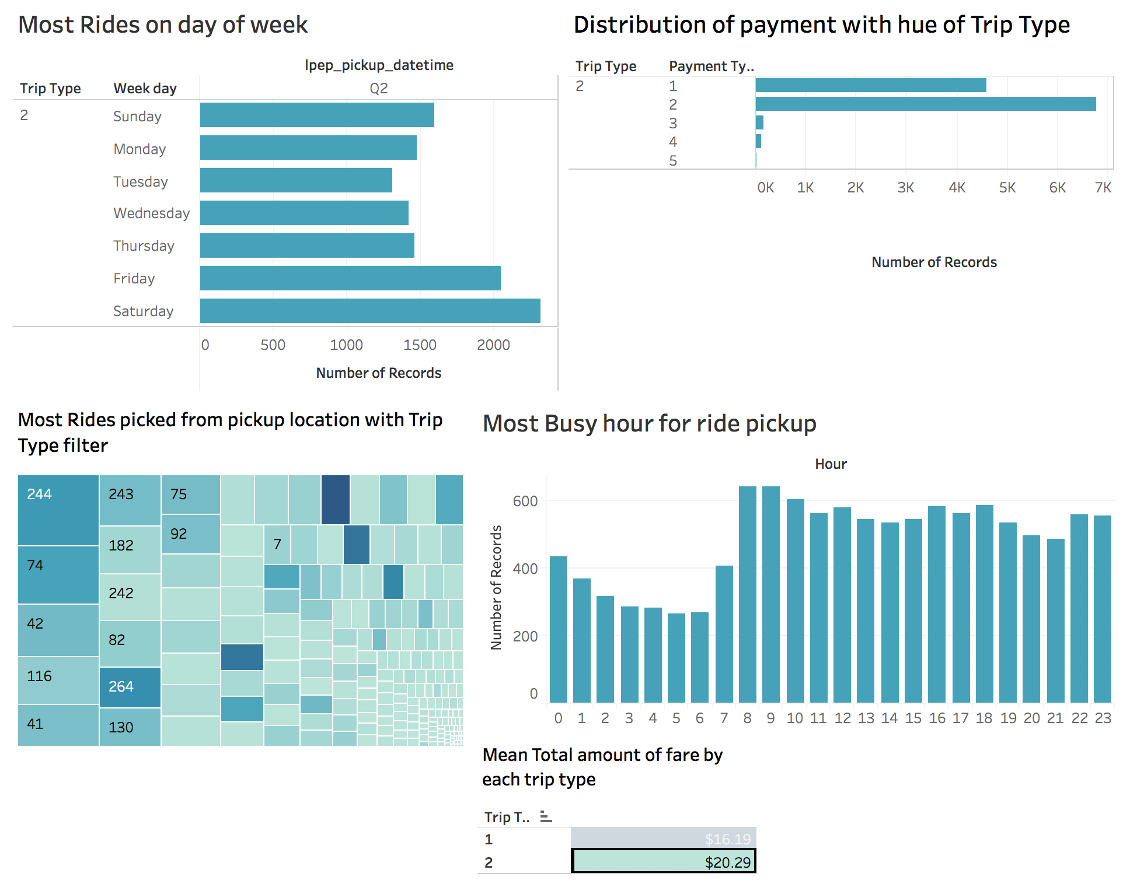
Dashboard for Dispatch trip type

Slide 16

Predictive Analytics
Classification - Logistic Regression
Variable Selection
- Heat Map
Back Tracking elimination
Independent and dependent variable
Predicting trip type for the test dataset
Model evaluation (confusion matrix)

Slide 17
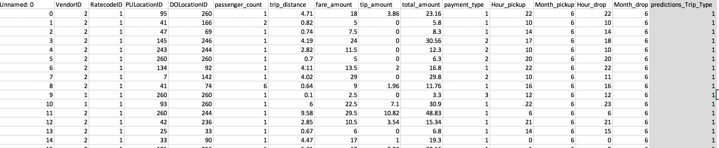
Predicted Output (trip type)

Slide 18
References:
Dataset - http://www.nyc.gov/html/tlc/html/about/trip_record_data.shtml
Data-Dictionary (Green taxi ride) http://www.nyc.gov/html/tlc/downloads/pdf/data_dictionary_trip_records_green.pdf

